Slide 1
Microbial Associations And The Rural/Urban Divide
Anthony Fodor
Department of Bioinformatics and Genomics
UNC Charlotte

Slide 2
Consulting:
Salix Corporation
Second Genome
Nkarta Corporation

Slide 3
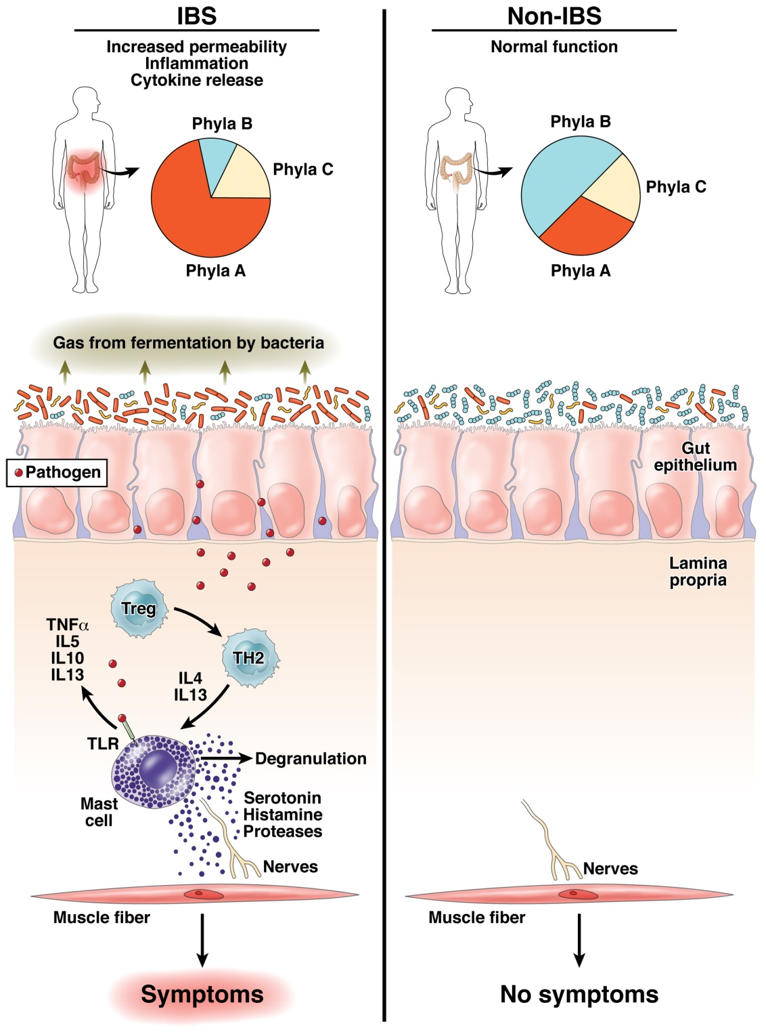
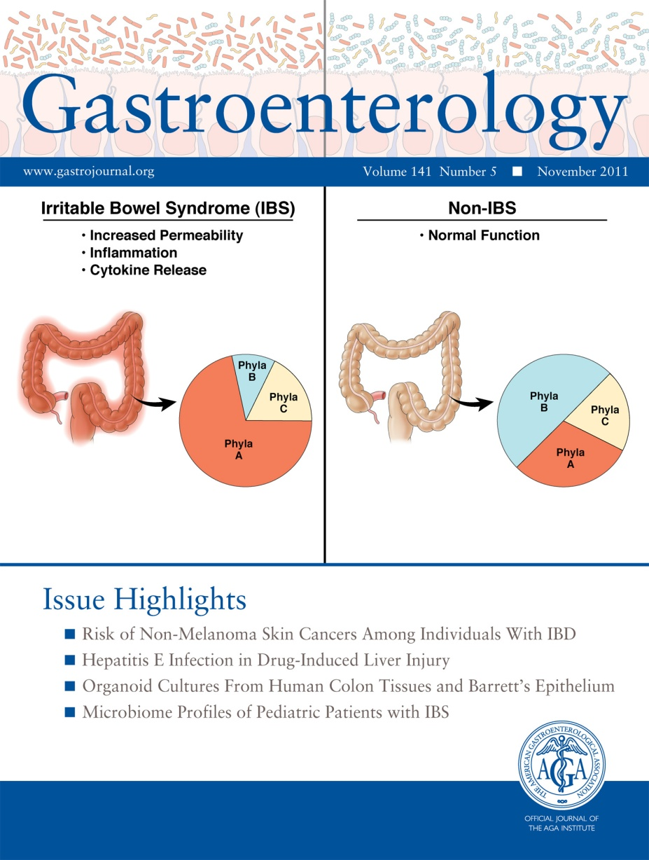
Does human variability in the microbiome impact health and disease?
Fodor & Talley. Gastroenterology. 2011

Slide 4
Effect Sizes in Association Studies are Reliably Small

Slide 5
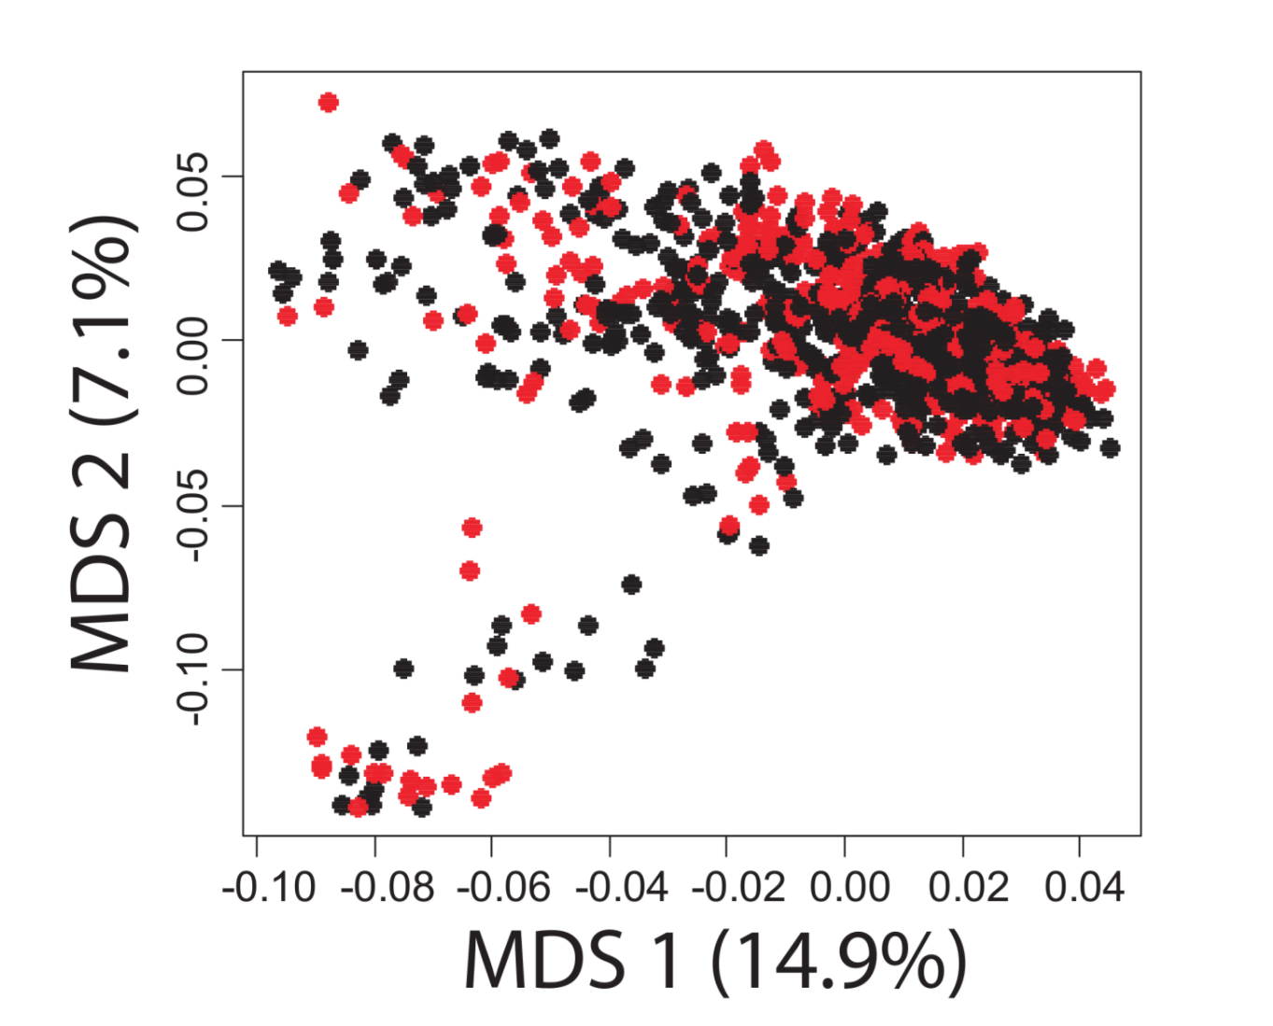


A case-control study in Colonic Diverticulosis with a small effect size
Roshonda Barner Jones
University of Southern California
Temitope Keku
UNC Chapel Hill
An Aberrant Microbiota is not Strongly Associated with Incidental Colonic Diverticulosis Roshonda B. Jones, Anthony A. Fodor, Anne F. Peery, Matthew C. B. Tsilimigras, Kathryn Winglee, Amber McCoy,Michael Sioda ,Robert S. Sandler, Temitope O. Keku2. Scientific Reports. 2018.

Slide 6
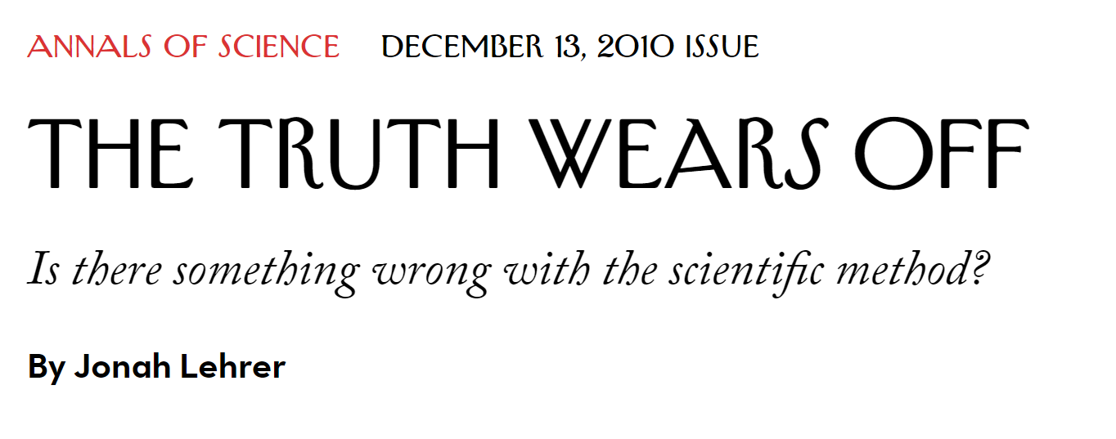
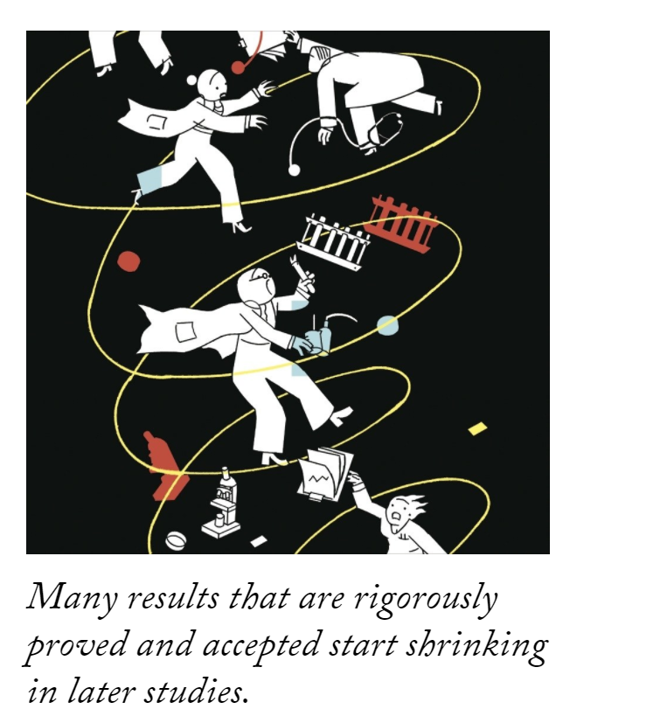

Slide 7
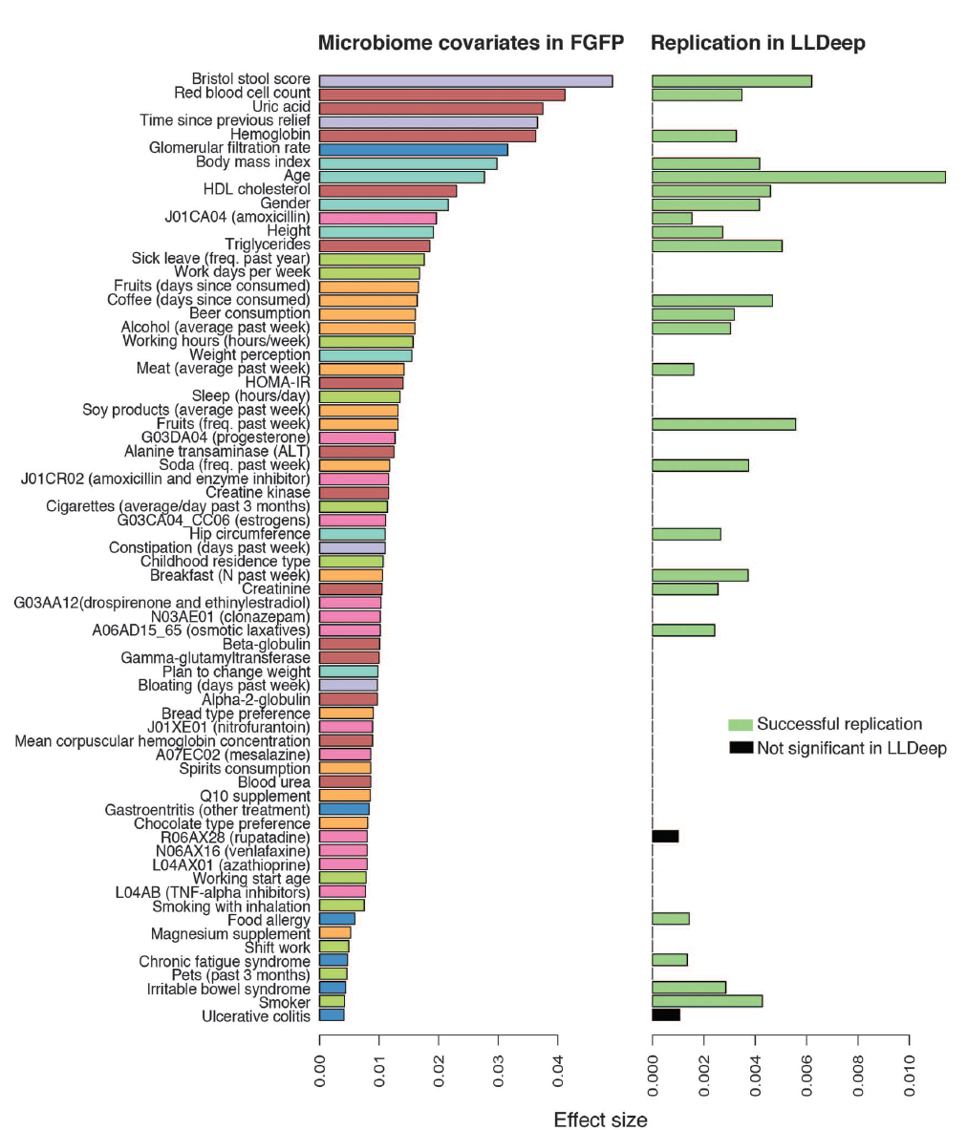
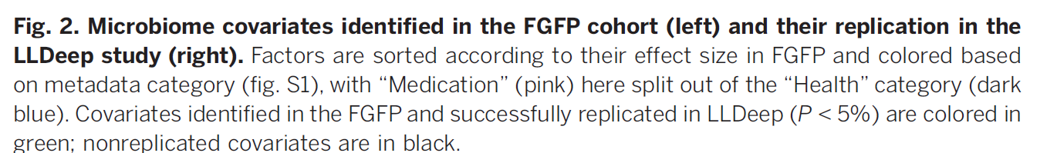
Microbial community composition and gene content is poorly associated with healthy variation
Initial analysis: 503 metadata variables
69 significant at 10% FDR
26 have analog in replication cohort
24 of these are significant
(but effect sizes in replicate cohort drop to << .01)
Power estimates suggests > 1600 subjects
needed to power BMI study…
Gwen Falony et al. Population-level analysis of gut microbiome variation -Science 29 Apr 2016

Slide 8
Effect Sizes in Association Studies are Reliably Small

Slide 9
Effect Sizes in Association Studies are Reliably Small
Go Big ( increase sample size )

Slide 10
Effect Sizes in Association Studies are Reliably Small
Go Big ( increase sample size )
Go Wide ( increase variability )

Slide 11
Effect Sizes in Association Studies are Reliably Small
Go Big ( increase sample size )
Go Wide ( increase variability )
Go Deep ( study mechanism )

Slide 12
Effect Sizes in Association Studies are Reliably Small
Go Big ( increase sample size )

Slide 13
A metagenomics pipeline consists of many, sometimes difficult to justify, choices
Experimental design
Visualization and statistical analysis
Sample Size (# of cages not just # of mice)
Properly consented cohorts
Capture of confounding variables
Sufficient variation across space and time
Negative and Positive controls
Which diversity metrics?
Log-transform data?
Parametric or non-parametric tests?
Simple linear models?
Mixed models?
Zero-inflated models?
Negative-binomial based models?
Correction for multiple hypothesis testing?
Remove rare taxa?
Track sequencing depth as a confounder.
Track potential biological confounders
(e.g. cage in mouse experiments; drugs in
human surveys)
Supervised classification to build predictive
models? Cross-fold validation?
Random Forest classifiers?
Reproducibility across cohorts and datasets
generated by different labs?
Ordination?
Unifrac (weighted or un-weighted).
or PcOA? With what distance metric
(Bray-Curtis?)
Multi-page, multi-factorial visualizations?
DNA extraction
Which extraction kit/protocol?
Which sequencing platform?
Whole genome or 16S? If 16S, which primers?
sequencing
Merged paired ends? With what parameters?
Qual score filter? With what parameters?
Filter against database of known sequences? With what parameters?
Chimera check? Which algorithm? With what parameters?
Sufficient sequencing depth? Remove unique sequences?
Classification/clustering
Reference database or denovo OTUs? Or something in between?
Which algorithm (RDP, kraken, greengenes, uparse)?
What database? With what parameters?
Are the sequences microbial? From the expected tissue?
Are they just kit microbes?
Normalization
Simple proportions? Rarefication (with what depth?
single rarefication vs. average).
Balance trees? Ratio space? Geometric Mean based normalization?

Slide 14
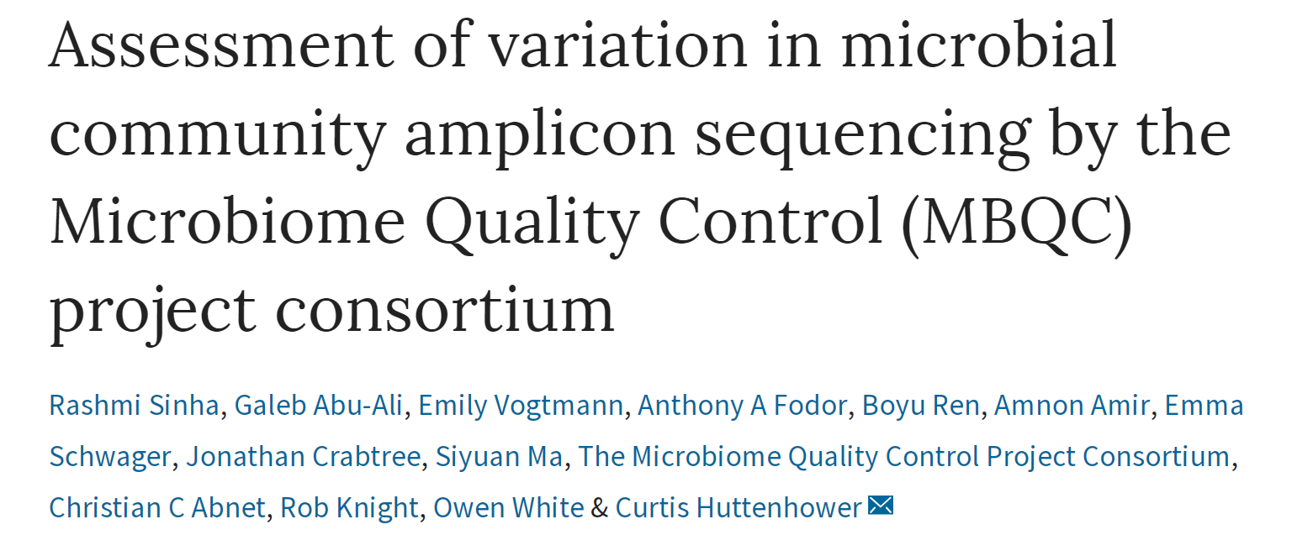
Extraction kits matter a lot
Absolute values of alpha diversity are unreliable
Different bioinformatics pipelines matter less than different wet lab protocols

Slide 15

Every analysis can be a meta-analysis
Michael Sioda – UNC Charlotte

Slide 16
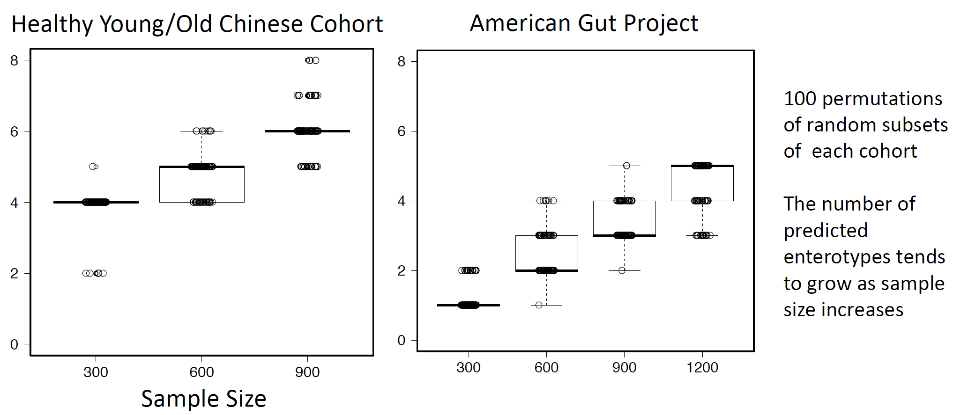

The number of Enterotypes detected via DMM appears dependent on study size
Matthew Brown Tsilimigras
UNC Charlotte
(In preparation)

Slide 17
Effect Sizes in Association Studies are Reliably Small
Go Big ( increase sample size )
Go Wide ( increase variability )

Slide 18
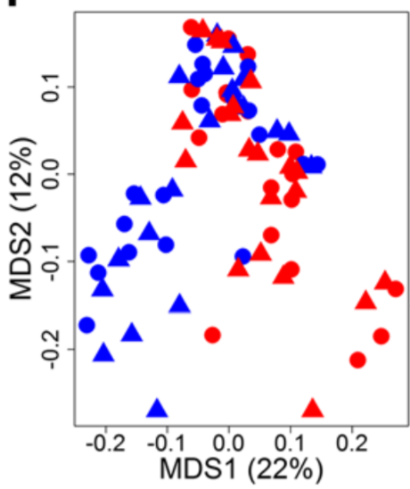

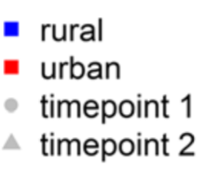
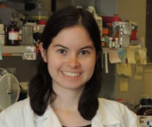

Microbial diversity can be increased by expanding our range of where we sample
Kathryn Winglee
CDC
Atlanta
Penny Gordon-
Larsen
UNC Chapel Hill
Recent urbanization in China is correlated with a Westernized microbiome encoding increased virulence and antibiotic resistance genes
Winglee et. al - Microbiome 2017

Slide 19
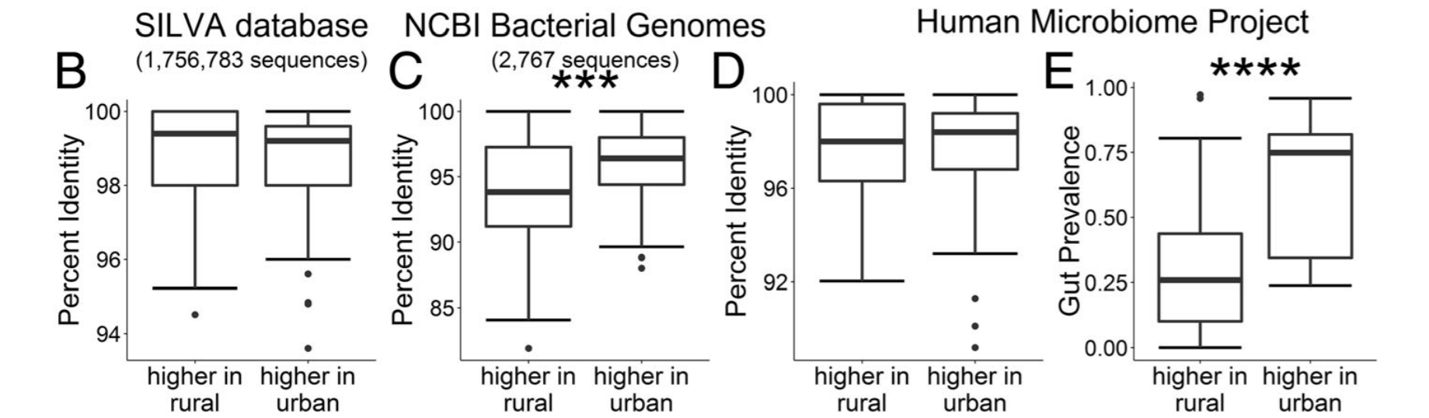
Microbial diversity can be increased by expanding our range of where we sample
Kathryn Winglee
CDC
Atlanta
Penny Gordon-
Larsen
UNC Chapel Hill
Recent urbanization in China is correlated with a Westernized microbiome encoding increased virulence and antibiotic resistance genes
Winglee et. al - Microbiome 2017

Slide 20
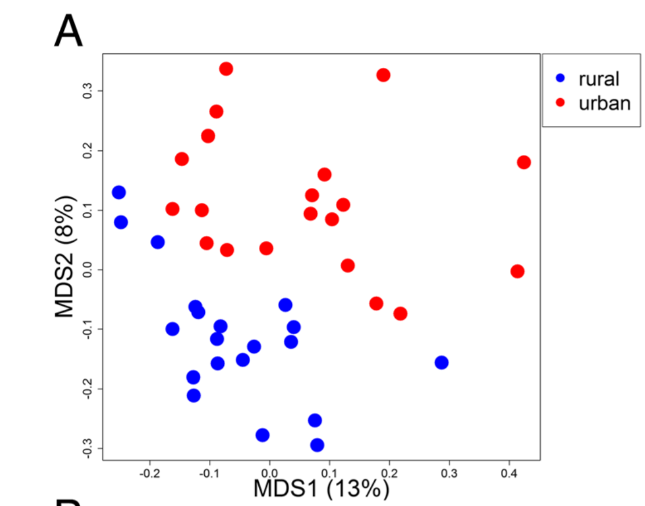
Microbial diversity can be increased by expanding our range of where we sample
Kathryn Winglee
CDC
Atlanta
Metabolites
Penny Gordon-
Larsen
UNC Chapel Hill
Recent urbanization in China is correlated with a Westernized microbiome encoding increased virulence and antibiotic resistance genes
Winglee et. al - Microbiome 2017

Slide 21
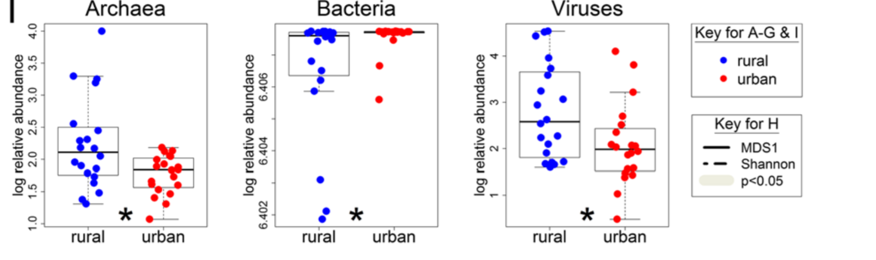
Metagenomic variability beyond bacteria is largely un-explored

Slide 22
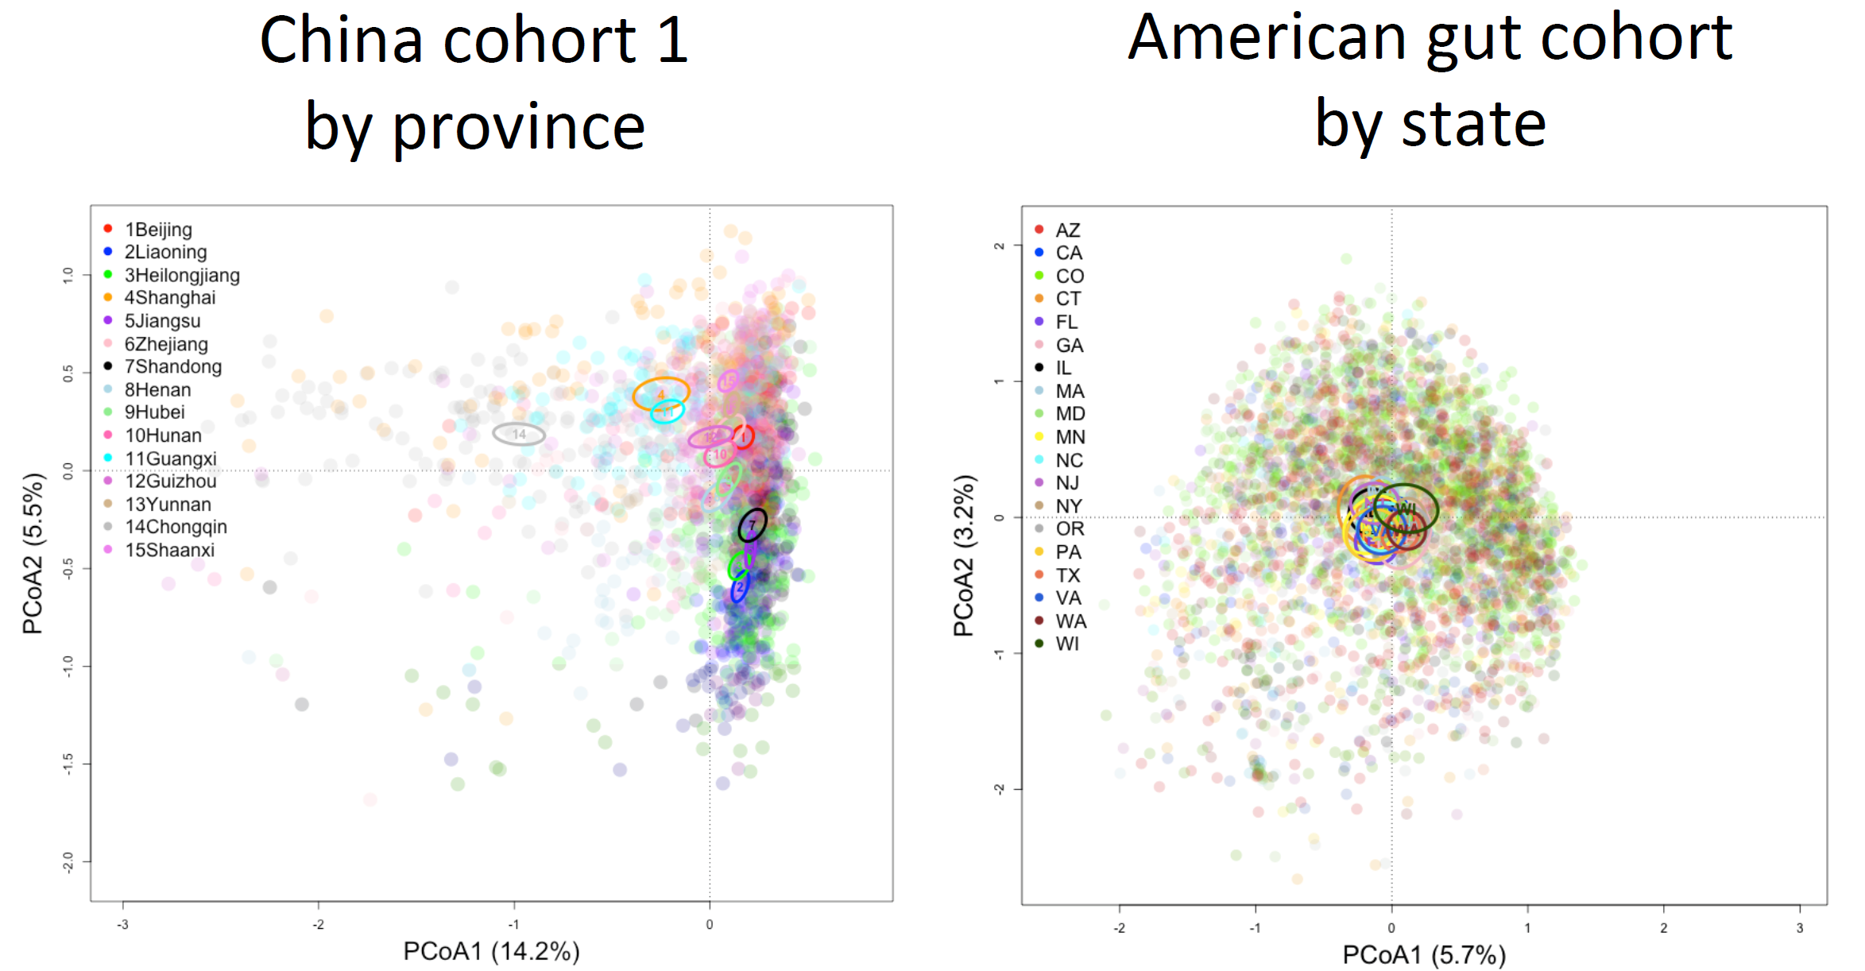

Chinese populations show more sequence variation than American cohorts
Shan Sun
UNC Charlotte
(unpublished)

Slide 23
Chinese populations show more sequence variation than American cohorts
Shan Sun
UNC Charlotte
(unpublished)

Slide 24
Chinese populations show more sequence variation than American cohorts
Shan Sun
UNC Charlotte
(unpublished)

Slide 25
Effect Sizes in Association Studies are Reliably Small
Go Big ( increase sample size )
Go Wide ( increase variability )
Go Deep ( study mechanism )

Slide 26
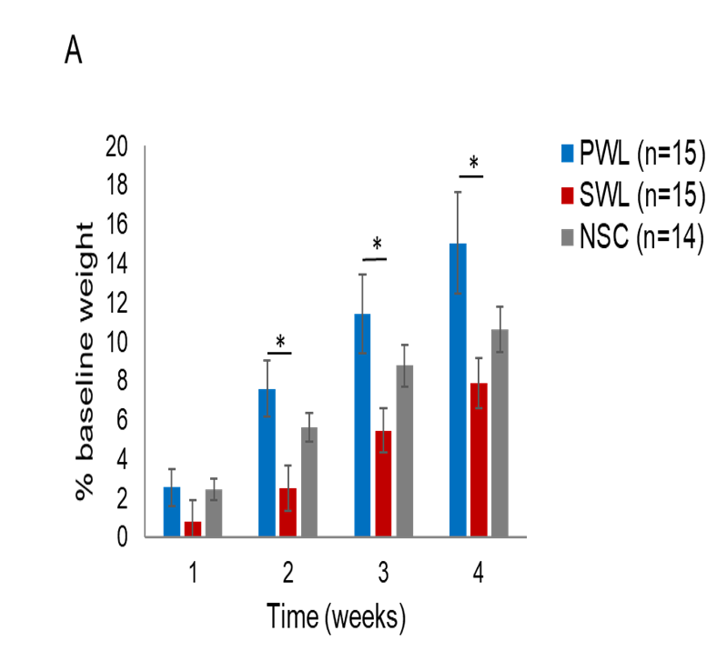

Transfer of phenotype to model systems confirms a functional role for the host microbiota
Farnaz Fouladi
UNC Charlotte
The Role of the Gut Microbiota in Sustained Weight Loss following Roux-en-Y Gastric Bypass Surgery
(in revision, Obesity Surgery)

Slide 27

What changes in a mouse transfer experiment?
Microbial Community from Feces to Slurry
Microbial Community from Slurry
to Mice
Healthy Control
n=4
n=1/donor
N=4
n=3-6/donor
N=21 slurries
n=1-3/slurry
n=12-14/donor
N=50 mice
Ian Carroll
UNC Chapel Hill
Anorexia before Treatment
n=4
n=1/donor
N=4
n=1-3/slurry
n=12-14 /donor
N=50 mice
n=5-7/donor
N=24 slurries
Anorexia after Treatment
n=4
Farnaz Fouladi
UNC Charlotte
n=1/donor
N=3
n=5-6/donor
N=23 slurries
n=1-4/slurry
n= 12-16 /donor
N=52 mice
Notes:
Fecal sample :1 sequencing of one donor from Anorexia after treatment failed (40T2)
In meta data we have 69 slurries……One slurry (HC 40) failed sequencing. 5 slurries of 40T2 was not included in fecal-slurry analysis because we don’t not have its fecal microbiota.
For a few number of mice we do not have the sequencing data of the slurries they receive so they are not included in the slurry-mice correlation analysis.

Slide 28
There is little loss of signal between fecal and slurry preps
Ian Carroll
UNC Chapel Hill
Farnaz Fouladi
UNC Charlotte

Slide 29
There is little overall correlation between mice and human taxa
Ian Carroll
UNC Chapel Hill
Farnaz Fouladi
UNC Charlotte

Slide 30
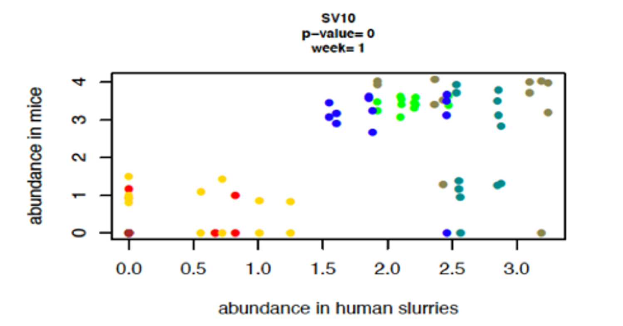
Correlations between mouse and human do not reflect
absolute abundance
Ian Carroll
UNC Chapel Hill
Farnaz Fouladi
UNC Charlotte

Slide 31

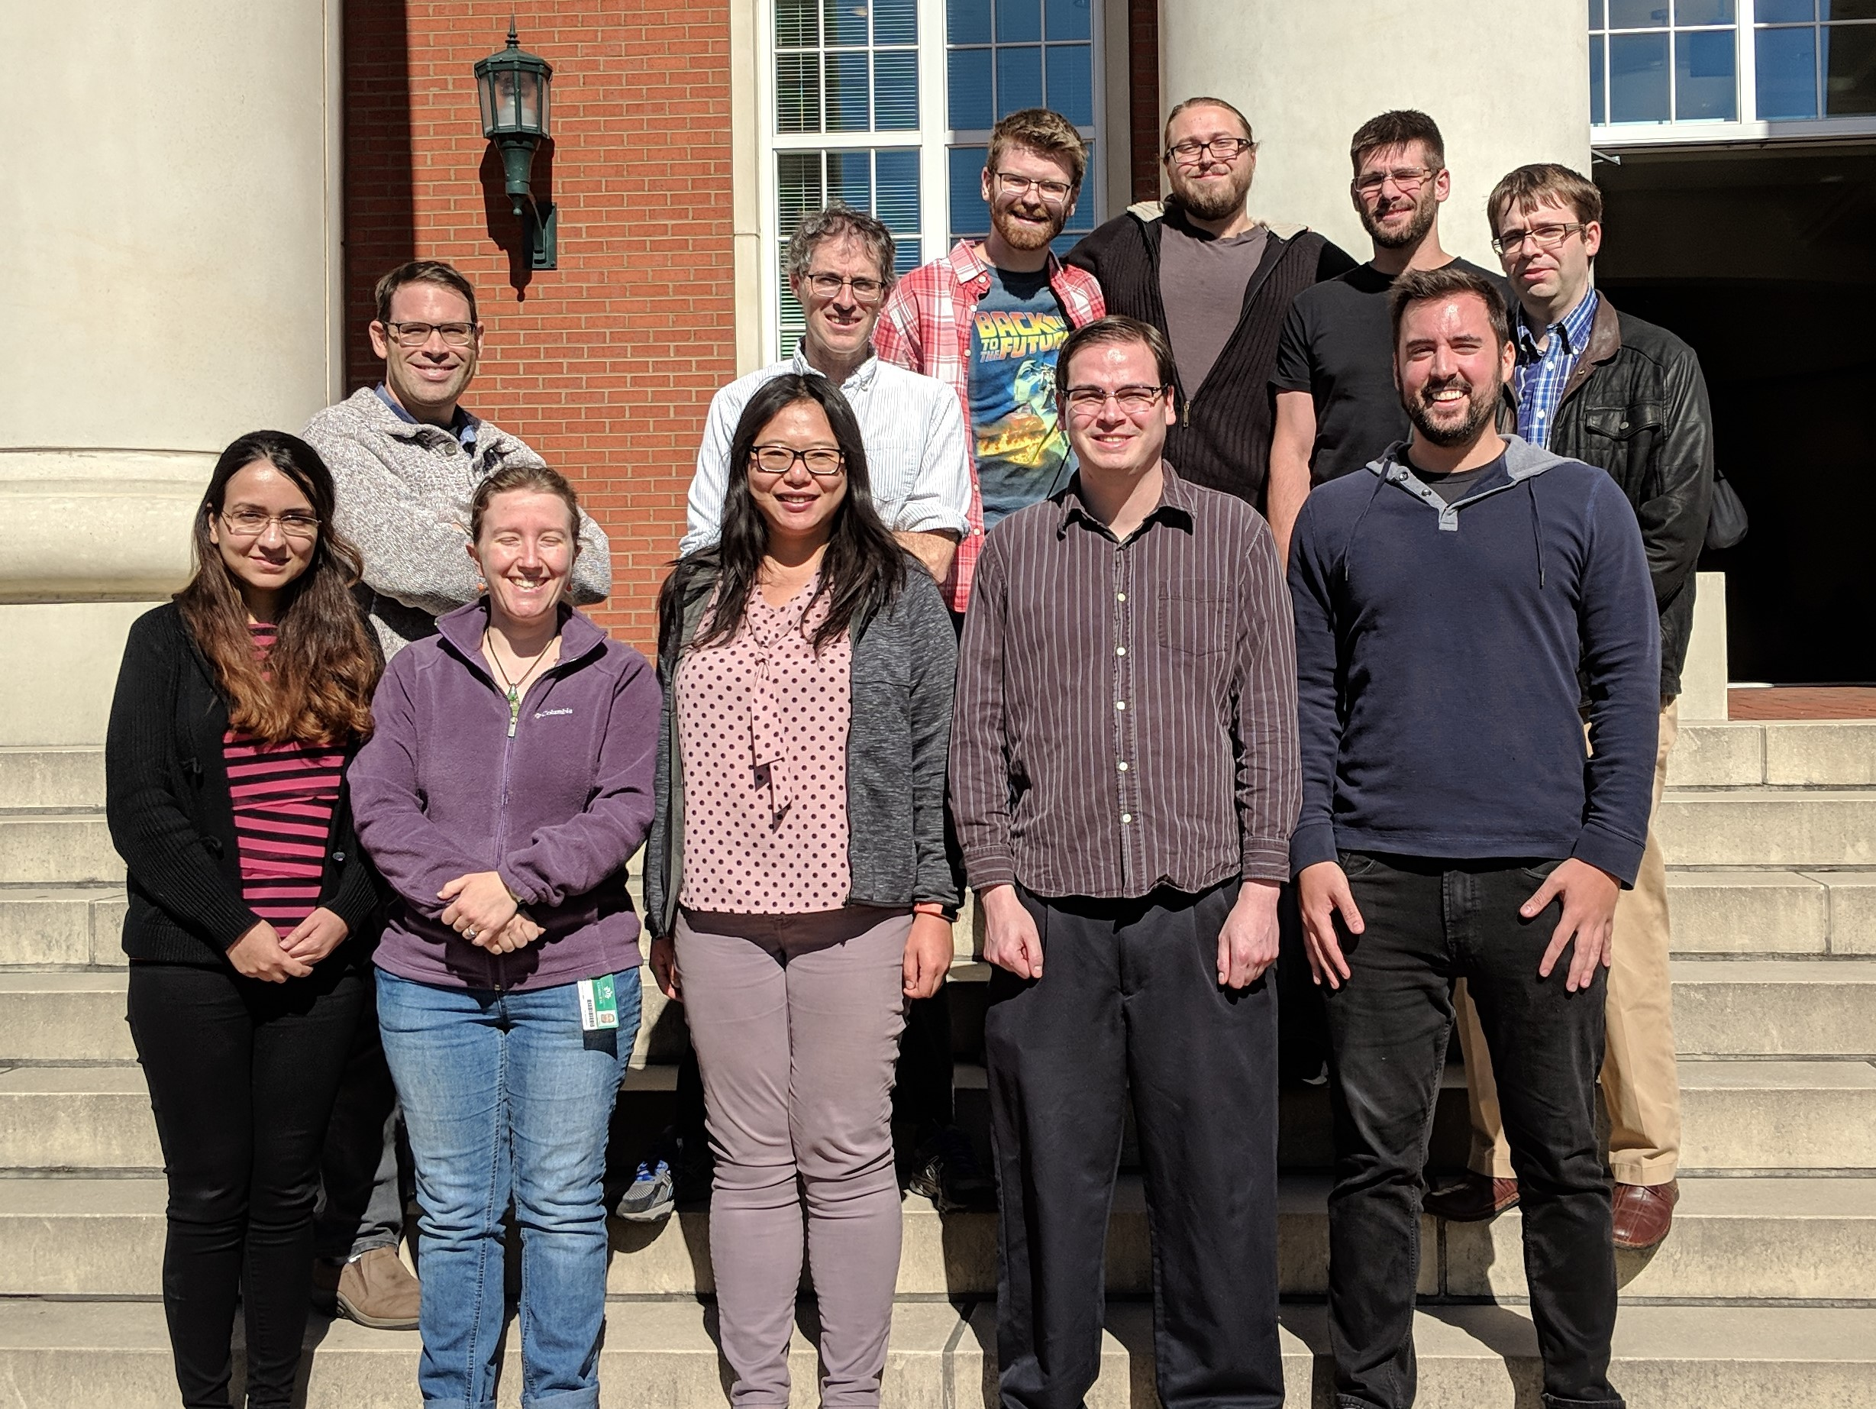

Slide 32










Acknowledgements
UNC-Chapel Hill
Janelle Arthur
Ian Carroll
Annie Green Howard
Marcus Muhlbauer
Penny Gordon-Larsen
Jonathan Hansen
Temitope Keku
UNC-Charlotte
Roshonda Barner
Matthew Brown
Farnaz Fouladi
Ra’ad Gharaibeh
Cynthia Gibas
Jon McCafferty
Shan Sun
Michael Sioda
Kathryn Winglee
Matthew Brown
UF- Gainesville
Christian Jobin
USC Vanderbilt University
Tanya L Alderete Martha J. Shrubsole
Michael Goran
Emily Noble
Scott Kanoski
Kathryn Winglee
Annie Green Howard
Penny Gordon-Larsen
Raad Gharaibeh
Jon McCafferty
Marcus Muhlbauer
Janelle Arthur
Christian Jobin

Slide 34
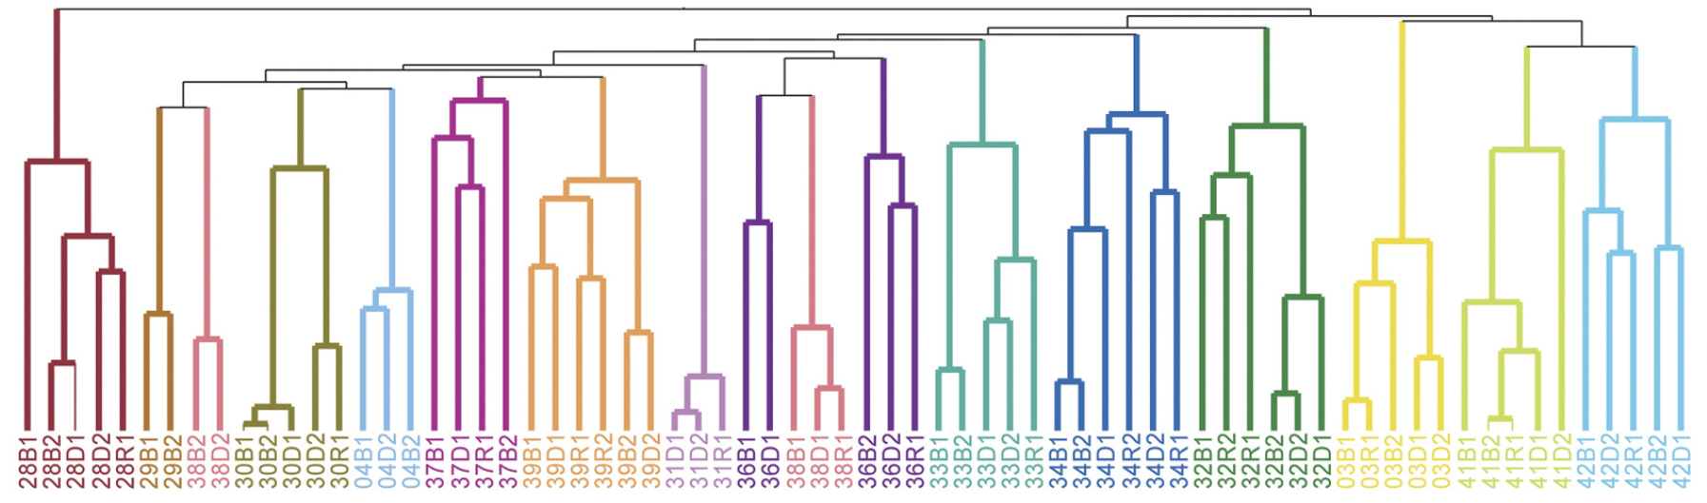


Individual differences in the microbial community are stable in response to a constant diet
Melanie Spencer
Carolinas HealthCare System
Steven Zeisel
UNC Chapel Hill
Association Between Composition of the Human Gastrointestinal Microbiome and Development of Fatty Liver With Choline Deficiency.
Gastroenterology. 2011.

Slide 35

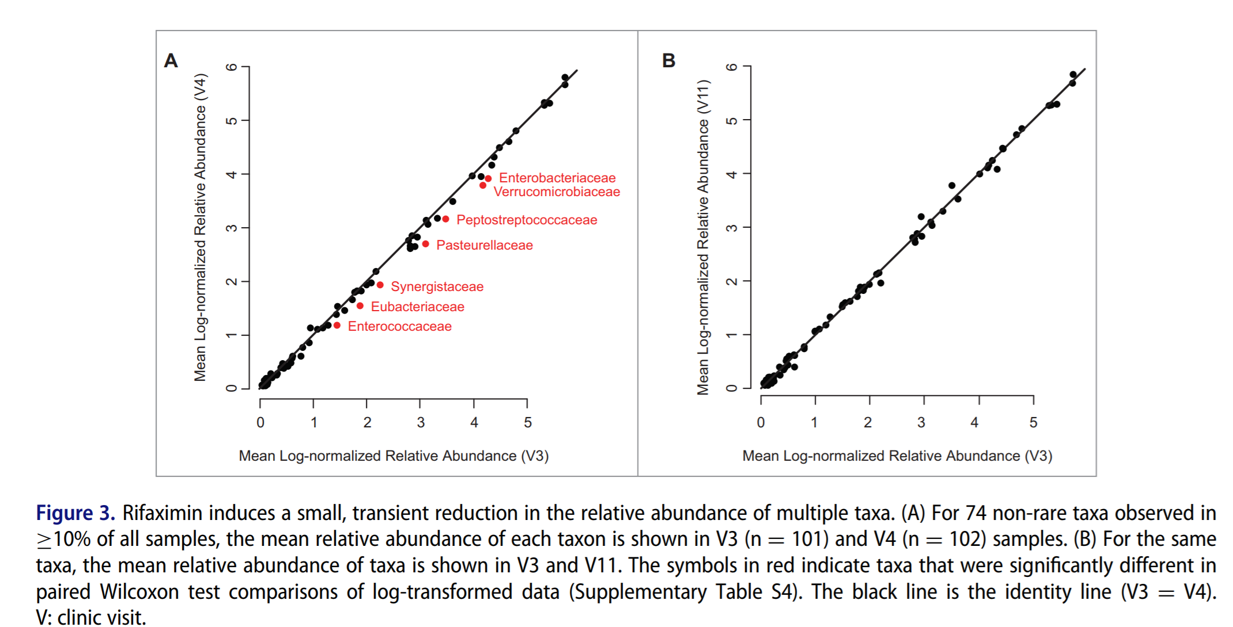
A pharmacological study with a small effect size
Rifaximin is associated with modest, transient decreases in multiple taxa in the gut microbiota of patients with diarrhoea-predominant irritable bowel syndrome. Gut Microbes. 2018

